Slide 1




Characterizing 9 mm Emission Detected Toward Class 0 Protostars
David E. Schenck
University of Arizona
Arizona/NASA Space Grant Undergraduate Research Internship Program Statewide Symposium
April 18, 2009

Slide 2
Protostars and Emission Processes
Class 0 protostars are forming stars who have not gained the majority of their eventual mass.
Dust emission can be described approximately as a greybody. Dust grains absorb light from the protostar and emits it at different wavelengths.
Free-free radiation is caused by charged particles accelerating near other charged particles.

Slide 3
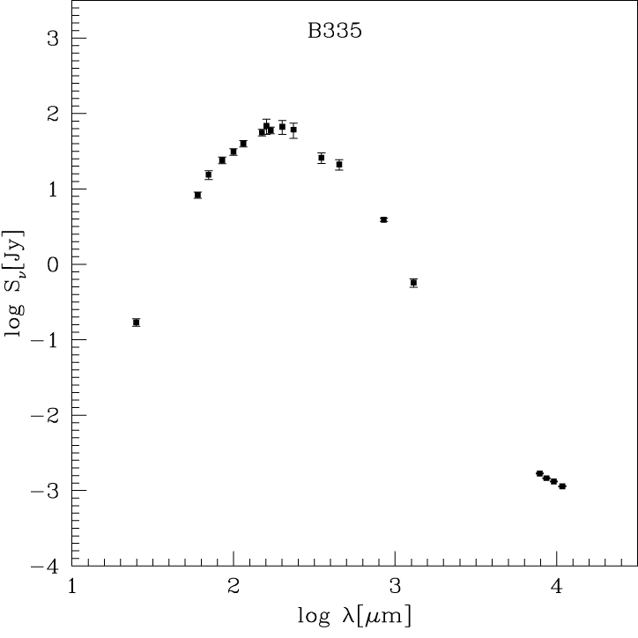
Spectral Energy Distributions
A spectral energy distribution (SED) represents the energy flux density detected from a source as a function of wavelength.

Slide 4
Goal
The purpose of the project was to determine which emitting process was responsible for emission at wavelengths around one centimeter.
Once an emitting process is identified, it may be possible to use SEDs to describe what is physically occurring at the protostar.

Slide 5
Methods
SEDs were produced for each of the five sources.
Dust emission and free-free radiation models were derived and compared to data taken over the past three decades.
I wrote programs that performed chi-squared model fitting, linear regressions, as well as for plotting.
Data was taken at the Green Bank Telescope in West Virginia.

Slide 6
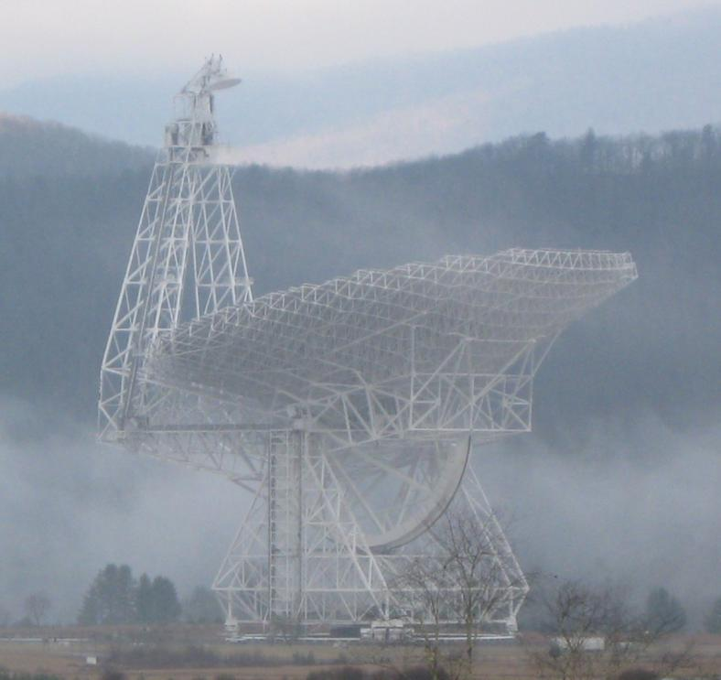
Green Bank Telescope

Slide 7
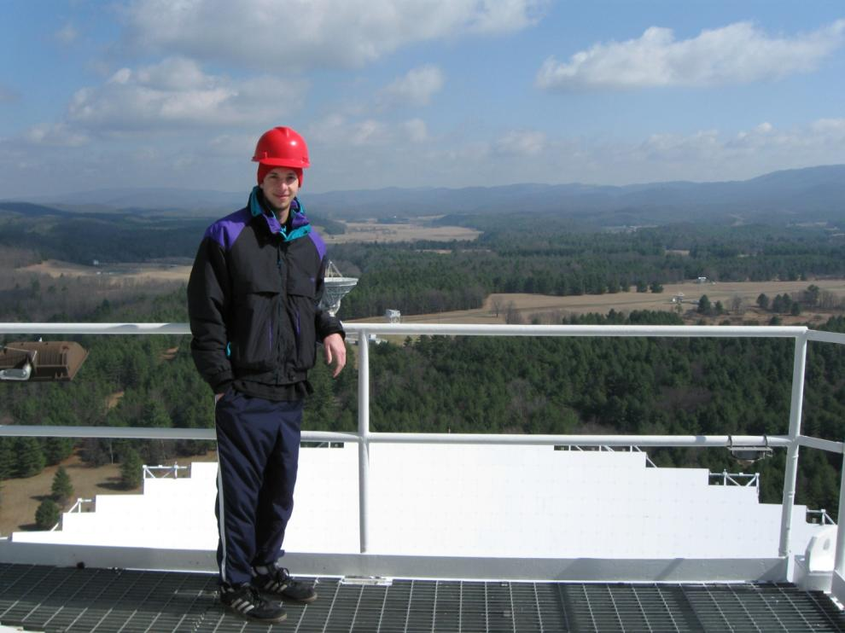
Green Bank Telescope

Slide 8
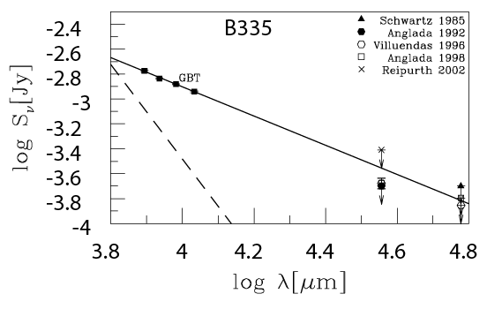
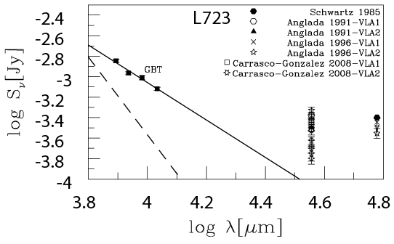

Results
SEDs of B335 and L723
Spectral Index:

Slide 9
Conclusion
SEDs indicate that free-free radiation dominates at centimeter wavelengths.
Accretion rate may be measurable by taking SEDs with the Green Bank Telescope.

Slide 10
Acknowledgements
Yancy Shirley: Mentor, Steward Observatory
Brian Mason, Jeff Mangum, Bill Cotton: NRAO
Susan Brew, Barron Orr, and the rest of the Space Grant team at Arizona
Thank You

